Slide 1
MongoDB Introduction
MongoDB is an open source, document oriented database that stores data in form of documents (key and value pairs).
Document based databases are one of types of NoSQL databases.

Slide 2
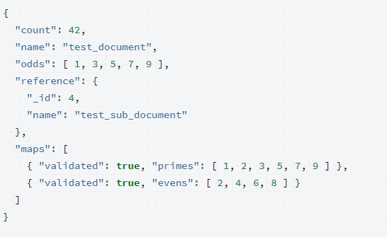
MongoDB Introduction
What is a document?
MongoDB is a document database: each record in a MongoDB collection is document. Documents are a structure composed of key and value pairs, similar to JSON objects or other mapping data types.
JSON is a way of representing objects derived from JavaScript; however, many programming environments have support for converting JSON objects into native mapping types. Documents in MongoDB are BSON, which is a binary data format that is like JSON, but includes additional type data.
Collections in MongoDB store groups of related documents, analogous to the concept of tables in relational systems: the structure of the documents in a single collection are generally similar. However, MongoDB does not require that all documents have the same structure
{ "_id": ObjectId(...), "name": "test_1", "active": true, "events": [ ] }
{ "_id": ObjectId(...), "name": "test_20", "active": true, "events": [ { "_id": 1, "type": "review" } { "_id": 2, "type": "inspection" } ] }

Slide 3
MongoDB Introduction
History of MongoDB
MongoDB was created by Eliot and Dwight (founders of DoubleClick) in 2007, when they faced scalability issues while working with relational database. The organization that developed MongoDB was originally known as 10gen.
In Feb 2009, they changed their business model and released MongoDB as an open source Project. The organization changed its name in 2013 and now known as MongoDB Inc.

Slide 4
MongoDB Introduction
Features of MongoDB
Indexing
Ad Hoc Queries
Support
Replication
Mongo DB Features
Aggregation
Load Balancing
High Performance
Large Media Storage
Horizontal Scalability

Slide 5
MongoDB Introduction
Features of MongoDB
MongoDB provides high performance. Most of the operations in the MongoDB are faster compared to relational databases.
MongoDB provides auto replication feature that allows you to quickly recover data in case of a failure.
Horizontal scaling is possible in MongoDB because of sharding. Sharding is partitioning of data and placing it on multiple machines in such a way that the order of the data is preserved. Horizontal scaling vs vertical scaling: Vertical scaling means adding more resources to the existing machine while horizontal scaling means adding more machines to handle the data. Vertical scaling is not that easy to implement, on the other hand horizontal scaling is easy to implement. Horizontal scaling database examples: MongoDB, Cassandra etc.
Load balancing: Horizontal scaling allows MongoDB to balanace the load.
High Availabilty: Auto Replication improves the availability of MongoDB database.
Indexing: Index is a single field within the document. Indexes are used to quickly locate data without having to search every document in a MongoDB database. This improves the performance of operations performed on the MongoDB database.

